Slide 1
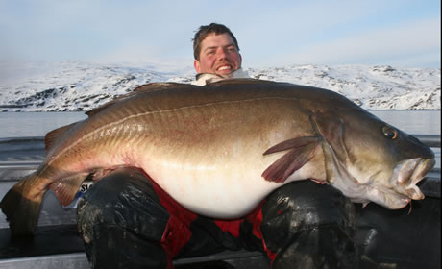
This is John. He is a fisherman from Alaska.
This is the largest fish he’s ever caught.

Slide 2
The problem is he needs to find out how much the fish weighs.

Slide 3
Here are some calculations he’s figured out.
Together, he and the fish weigh 382.6 lbs.
He weighs 294.3 lbs.
Using this information,
how much does the fish weigh?
How did you arrive at your solution?

